Slide 1
Understanding Probabilistic Programming Inference
Frank Wood
fwood@robots.ox.ac.uk
http://www.robots.ox.ac.uk/~fwood
MLSS 2014
April, 2014 Reykjavik

Slide 2
Probabilistic Programming Concepts
Last Time
Procedures “sample”
Programs are generative models
This Time
“Sampling” execution traces = inference
Different traces arise from stochastic procedure outputs
Elementary
flip, normal, discrete, poisson, gamma, …
Compound
(lambda (a b) (if (flip a)
(+ (poisson b) 7)
(normal a b)))
Observations weight execution traces

Slide 3
Outline
Review
Monte Carlo-based probabilistic inference
Rejection Sampling
MCMC
SMC
PMCMC
Programming Language
Interpretation
Trace Probability
Correspondence To Code
Probabilistic Program Interpretation

Slide 4
Probabilistic Inference

Slide 5
Monte Carlo Integration

Slide 6
Rejection Sampling

Slide 7
Rejection Sampling
Figure from Bishop “Pattern Recognition and Machine Learning”

Slide 8
Rejection Sampling

Slide 9
Rejection Sampling

Slide 10
Metropolis Hastings

Slide 11
Importance Sampling

Slide 12
Sequential Importance Resampling
SIR Targets
With a weighted set of particles
Noting the identity
We can use importance sampling to generate samples from
Given our sample-based approximation to

Slide 13
Sequential Importance Resampling

Slide 14
Inference In State Space Models
Consider inference in a state space model
Return to state space model
can’t use SMC
single-site updates won’t mix

Slide 15
“Ideal” Inference
Ideal MH
intractable.
SMC provides unbiased estimate
Return to state space model
Del Moral “Feynman-Kac Formulae: Genealogical and Interacting Particle Systems with Applications”

Slide 16
Particle Marginal Metropolis Hastings
MH with unbiased likelihood estimates
computed via SMC proposal
targets correct distribution!
Return to state space model
PMCMC / Particle Gibbs
C. Andrieu, A. Doucet, R. Holenstein Particle Markov Chain Monte Carlo methods

Slide 17
SMC Methods Discussed Require Only
Initialization
can be sampled
Run
can be sampled (blackbox)
Observe
can be point-wise evaluated up to constant multiple

Slide 18
Correspondence Between Generative Program And Execution Trace Probability
Example generative program

Slide 19
Program Interpretation
Best Computer Science Textbook?
Abelson, Sussman and Sussman “Structure and Interpretation of Computer Programs”

Slide 20
Metacircular Evaluator
eval
apply
(define (eval exp env)
(cond
((self-evaluating? exp) exp)
((variable? exp) (lookup-variable-value exp env))
((quoted? exp) (text-of-quotation exp))
((assignment? exp) (eval-assignment exp env))
((definition? exp) (eval-definition exp env))
((if? exp) (eval-if exp env))
((lambda? exp)
(make-procedure (lambda-parameters exp)
(lambda-body exp) env))
((begin? exp)
(eval-sequence (begin-actions exp) env))
((cond? exp) (eval (cond->if exp) env))
((application? exp)
(apply (eval (operator exp) env)
(list-of-values (operands exp) env)))
(else
(error
"Unknown expression type -- EVAL" exp))))
(define (apply procedure arguments)
(cond
((primitive-procedure? procedure)
(apply-primitive-procedure procedure arguments))
((compound-procedure? procedure)
(eval-sequence
(procedure-body procedure)
(extend-environment
(procedure-parameters procedure)
arguments
(procedure-environment procedure)
)
)
)
(else
(error
"Unknown procedure type – APPLY” procedure))))
Copied from Abelson, Sussman and Sussman “Structure and Interpretation of Computer Programs”

Slide 21
Execution Trace Probability
Forward interpretation generates sequences of stochastic procedure applications
Observed value
Parameter of observation distribution
Type of observation distribution
Interpreter memory state
Parameter of stochastic procedure
Type of stochastic procedure

Slide 22
Observe Statements

Slide 23
What is ?

Slide 24
What is ?

Slide 25
Traditional Generative Models
Programs can be written that correspond to traditional generative statistics models
Always unfold into a joint with same number and types of elementary random procedure applications

Slide 26
Example : Hidden Markov Model
How do you know in advance that this will be true?

Slide 27
Traditional Generative Models
Programs can be written that correspond to traditional generative statistics models
Always unfold into a joint with same number and types of elementary random procedure applications
This is not true for general programs
Worst case
Fully connected graphical model (full joint parameterization)
Complex, non-linear, non-differentiable, non-invertible functional dependencies

Slide 28
Rejection Sampling
Run program forward and condition on all observations exactly matching the observed output
Copied from Goodman “The Principles and Practice of Probabilistic Programming”

Slide 29
Single Site MCMC = “Random DB”
Sample posterior distribution of execution traces using joint with observed values plugged in
Metropolis-Hastings acceptance rule
Need
Proposal
Have
Likelihoods (via observe statement restrictions)
Prior (sequence of ERP returns; scored in interpreter)
Lightweight Implementations of Probabilistic Programming Languages Via Transformational Compilation [Wingate, Stuhlmüller et al, 2011]

Slide 30
RDB MH Proposal
Probability of new part of
proposed execution trace
Single stochastic
procedure (SP) output
Number of SP’s in
original trace
Probability of new SP return value (sample) given trace prefix
Random Database [Wingate, Stuhlmüller et al, 2011]

Slide 31
RDB Implementation
Single site update = sample from the prior = run program forward
Simplified MH acceptance ratio
Number of SP applications
in original trace
Probability of regenerating current trace
continuation given proposal trace beginning
Number of SP applications
in new trace
Probability of generating proposal trace
continuation given current trace beginning
Random Database [Wingate, Stuhlmüller et al, 2011]

Slide 32
Single-Site Metropolis Hastings / RDB
[Wingate, Stuhlmüller et al, 2011] Lightweight Implementations of Probabilistic Programming Languages Via Transformational Compilation

Slide 33
SMC for Prob. Prog. = Simple, Parallel
SMC approximates the target density with a set of realized traces
A sample/particle = trace = a sequence of interpreter memory states

Slide 34
Sequential Monte Carlo for Prob. Prog. Inf.
State-space-model-like decomposition
Suggests Sequential Importance Resampling (SIR)
Proposal
Run program forward
until next observe directive
Weight of particle
Is observation likelihood

Slide 35
Relationship To State Space Model
No fixed parameter
Program generates all random variables
State is interpreter memory state
Transition is stochastic procedure application
Only observes need be indexed
Eager parameter
generation
Lazy parameter
generation

Slide 36
Sequential Monte Carlo
Paige and W. “A Compilation Target for Probabilistic Programming Languages.” ICML, 2014

Slide 37
Particle Markov Chain Monte Carlo (PIMH)
Run SMC
Compute marginal likelihood estimate
Do forever
Re-run SMC
Compute new marginal likelihood estimate
Accept particle set with probability
Emit predictions from all particles in next set (new and/or old)
Run SMC

Slide 38
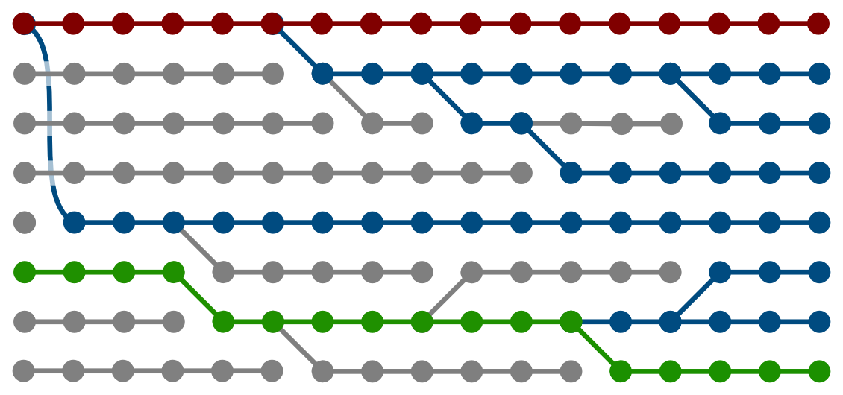
PMCMC for Prob. Prog.
Particle Gibbs
MH w/ accept prob. = 1
SMC “inner-loop” proposal
“Retained particle”
Non-local
Single “sweep” can propose changes to many variable values at once
[Holenstein 2009; Andrieu, Doucet, Holenstein 2010; etc]
Wood, van de Meent, Mansinghka “A New Approach to Probabilistic Programming Inference” AISTATS 2014

Slide 39
Compiled PMCMC Algorithm Performance
What’s the right inference algorithm for the model?
What’s the right performance measure?

Slide 40
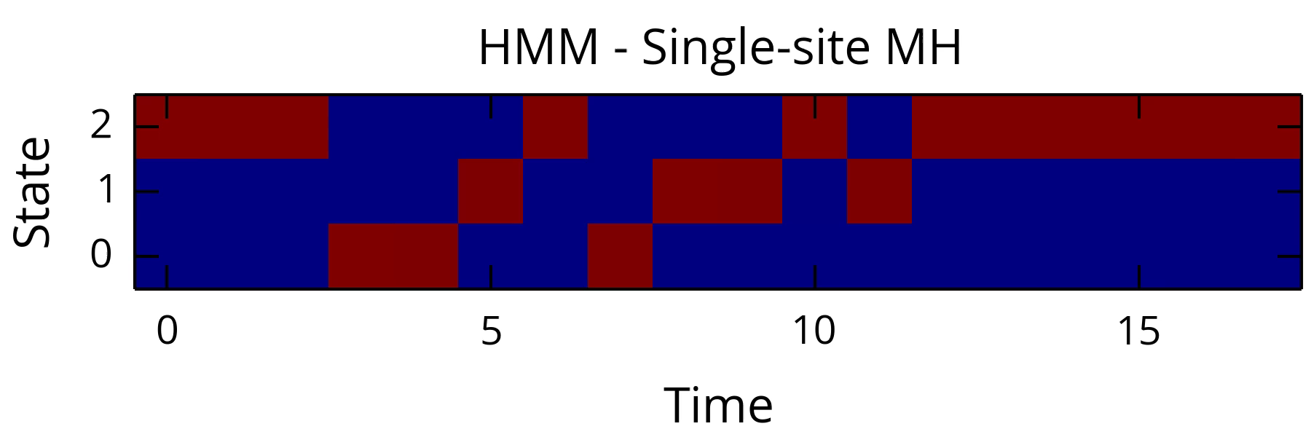

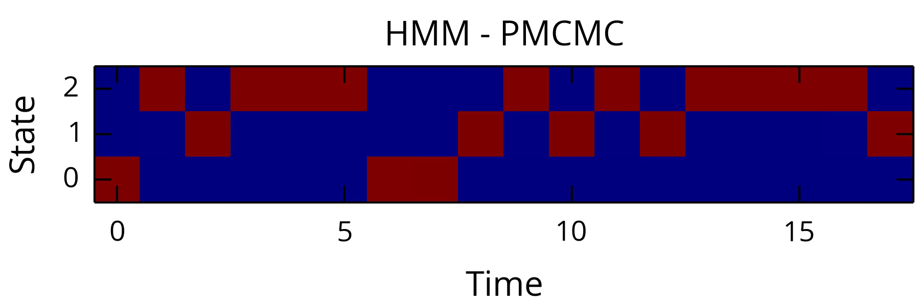





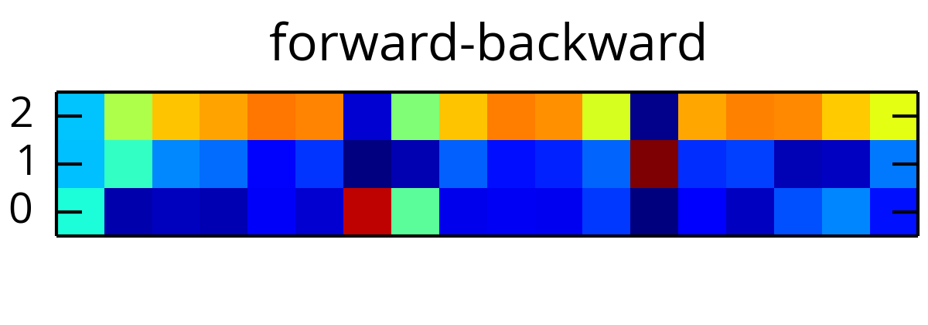
PMCMC HMM Visualization

Slide 41
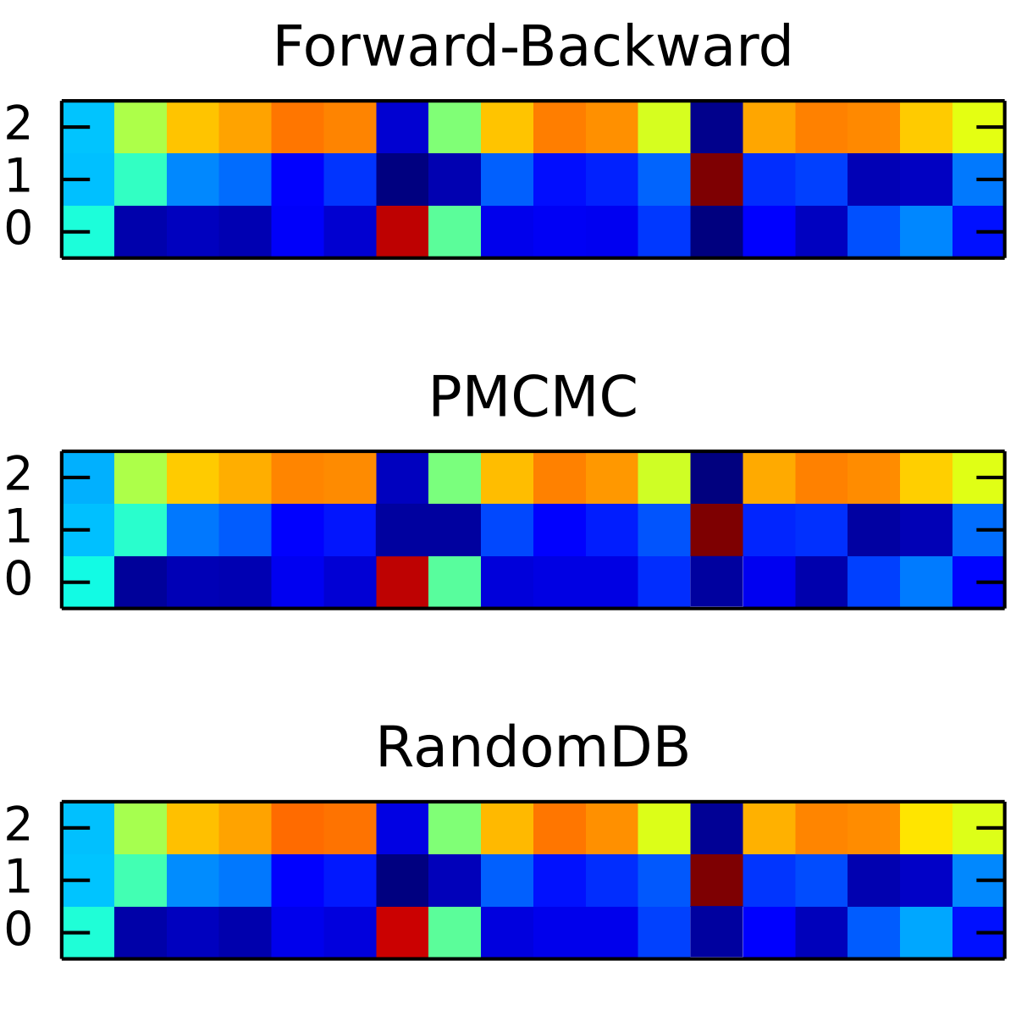
Anglican : Particle MCMC Inference
Wood, van de Meent, Mansinghka “A new approach to probabilistic programming inference.” AISTATS, 2014
Wingate et al “Lightweight implementations of probabilistic programming languages via transformational compilation” AISTATS, 2011

Slide 42
Opportunity : Optimizing Inference by Program Line Reordering

Slide 43
What if dirac Observes?
Show up as constraints in joint
dirac observes are constraints
=> SMC / PMCMC reduce to rejection / repeated rejection sampling if all observes are constraints

Slide 44
Limitations / Goals
New paths to efficient, scalable probabilistic programming inference
True hope for automatic inference
PMCMC not optimized at all
Sampling from prior
Multinomial sampling
Ancestral sampling
Still gets stuck (eagerness hurts)
AI Goal
Hill-climbing in a broad set of models

Slide 45
Exercises
http://www.robots.ox.ac.uk/~fwood/anglican/teaching/mlss2014/
How Probabilistic Programming Works; The Actual Randomness Sampled When Exploring Traces
http://www.robots.ox.ac.uk/~fwood/anglican/teaching/mlss2014/poisson_generative_procedure/
Why Developing Models Is Easy in Probabilistic Programming Languages but Eagerness Hurts
http://www.robots.ox.ac.uk/~fwood/anglican/teaching/mlss2014/bayesian_matrix_factorization/

